Slide 1


APPOINMENT BOOKING SYSTEM
By : TUSHAR MAKAVANA

Slide 2


Overview
Introduction
Key Features
User Benefits
Concept
Admin Panel
User Privacy
Project

Slide 3

Introduction
Our project addresses this need by introducing a streamlined Appointment Booking System developed using React.js, coupled with CRUD (Create, Read, Update, Delete) operations.
With its intuitive interface, robust functionality, and focus on efficiency and security, our system empowers clinics to deliver exceptional healthcare services while optimizing their operational workflow.

Slide 4

Key Features
User-Friendly Interface
FEATURES
Real-time Updates
Customization Options
CRUD Operations

Slide 5

USER BENEFITS
My Appointment Booking System redefines the patient experience by offering a seamless, user-friendly platform for scheduling medical appointments. With its intuitive interface, mobile accessibility, and emphasis on personalization and convenience, our system empowers patients to take control of their healthcare journey with confidence and ease.
Convenienc
Empowerment
Reduced Wait Times
By offering a seamless booking process accessible from any device, our system eliminates the hassle of traditional appointment scheduling methods, saving patients time and effort.
Patients have greater control over their healthcare journey, with the ability to schedule appointments at their convenience and with their preferred healthcare providers.
Real-time availability updates enable patients to secure appointments quickly, reducing wait times and ensuring timely access to medical care.

Slide 6



Concept
Digital Transformation
Data-Driven Insight
Integration and Scalability
My project represents a paradigm shift in how clinics approach appointment scheduling. By transitioning from traditional methods to a digital platform, clinics can streamline their operations and deliver a more efficient and patient-centric experience.
By harnessing the data generated through the booking system, clinics gain valuable insights into patient behavior, appointment trends, and resource utilization.
My concept is designed with integration and scalability in mind, allowing seamless integration with existing clinic management systems and scalability to accommodate future growth and expansion.

Slide 7

Admin Panel
Admin Panel serves as a powerful tool for clinics to streamline administrative processes, optimize resource management, and improve overall efficiency.
Appointment Management
Staff Management
Resource Allocation
The Admin Panel provides clinic staff with a centralized dashboard for managing appointments, including scheduling, rescheduling, and cancelation. Real-time updates ensure accurate and up-to-date appointment tracking.
Clinic administrators can efficiently manage staff schedules, assign roles and responsibilities, and track performance metrics. User permissions and access controls ensure data security and confidentiality.
The Admin Panel facilitates resource allocation and optimization by providing insights into equipment utilization, room availability, and inventory management.

Slide 8
Data Encryptio
All user data, including personal information and medical records, is encrypted both in transit and at rest to prevent unauthorized access and ensure confidentiality.
01
User Authentication
Secure user authentication mechanisms, such as multi-factor authentication (MFA) and strong password policies, are implemented to verify the identity of users and prevent unauthorized access to sensitive data.
User Privacy
Our project, the Appointment Booking System, places a high priority on safeguarding user privacy through a combination of robust security measures, compliance with regulatory standards, and ethical data handling practices.
Data Minimization
Only essential user data required for the appointment booking process is collected and stored, minimizing the risk of exposure and ensuring compliance with principles of data minimization.
Secure Communication
All communication between the user's device and the server is encrypted using industry-standard protocols (e.g., HTTPS), preventing interception and eavesdropping of sensitive information.

Slide 9
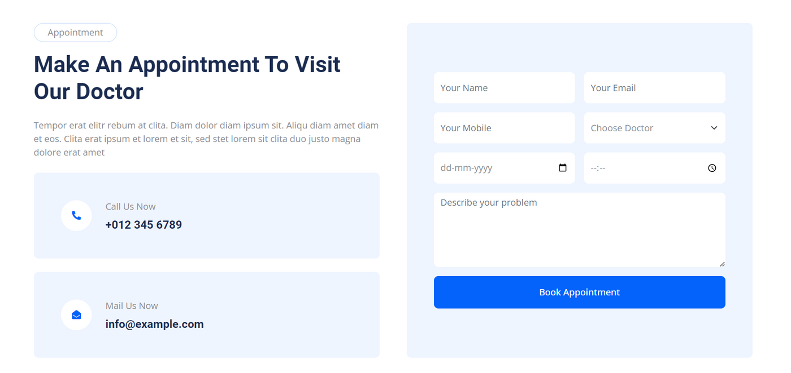
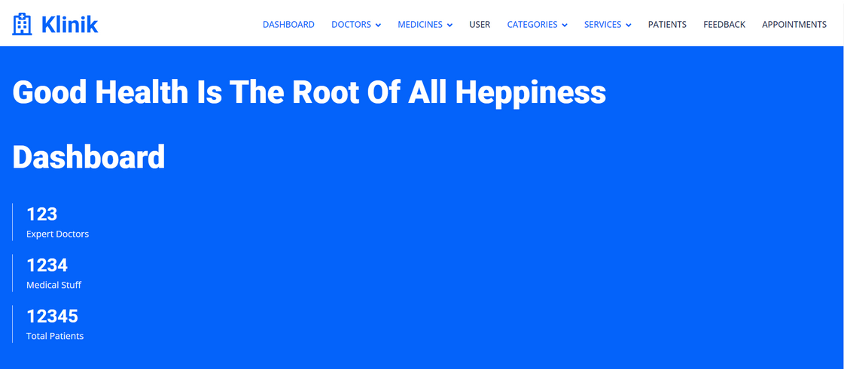
PROJECT
Aaron Loeb
Appointment Book
Admin Dashboard
Olivia Wilson

Slide 10
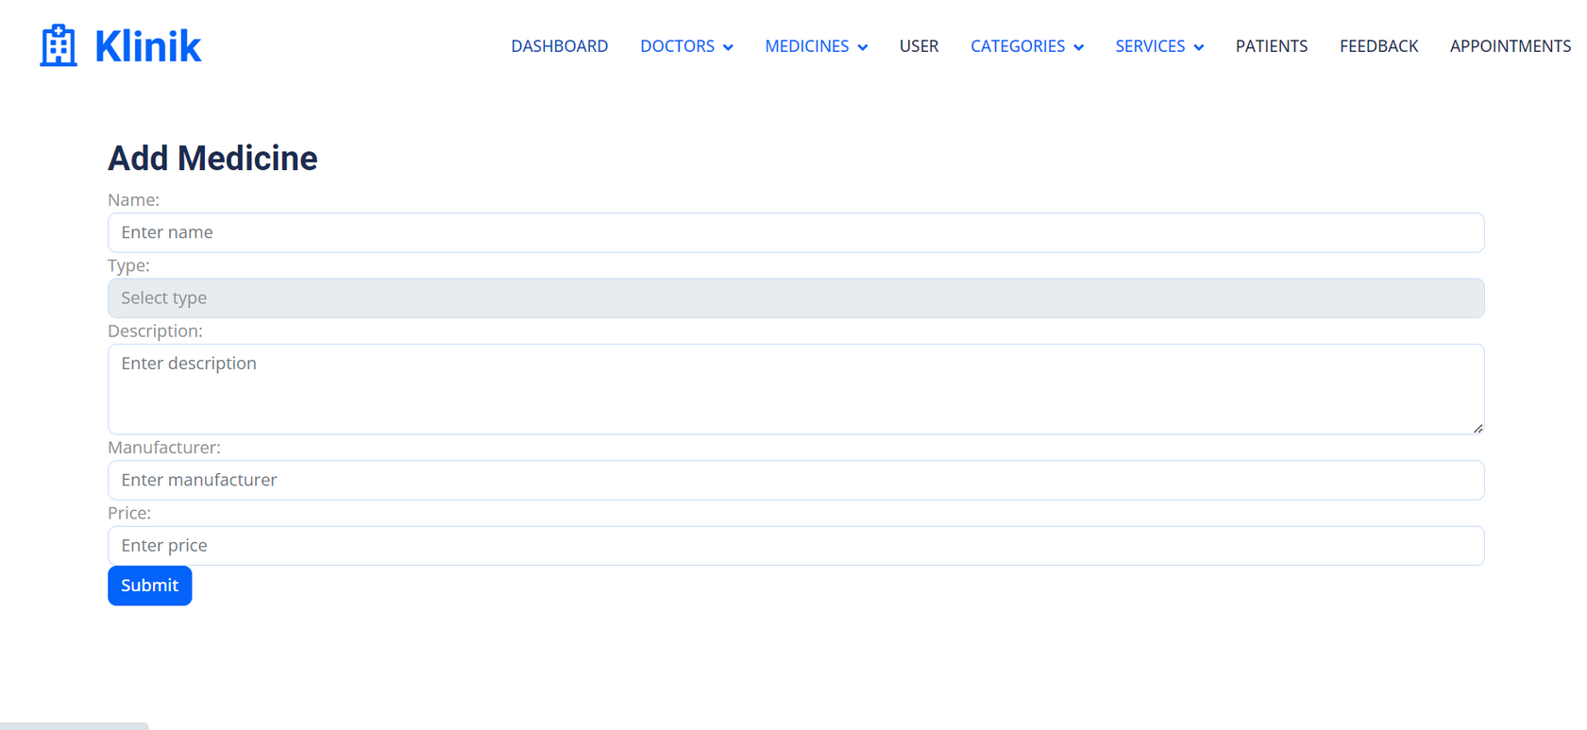
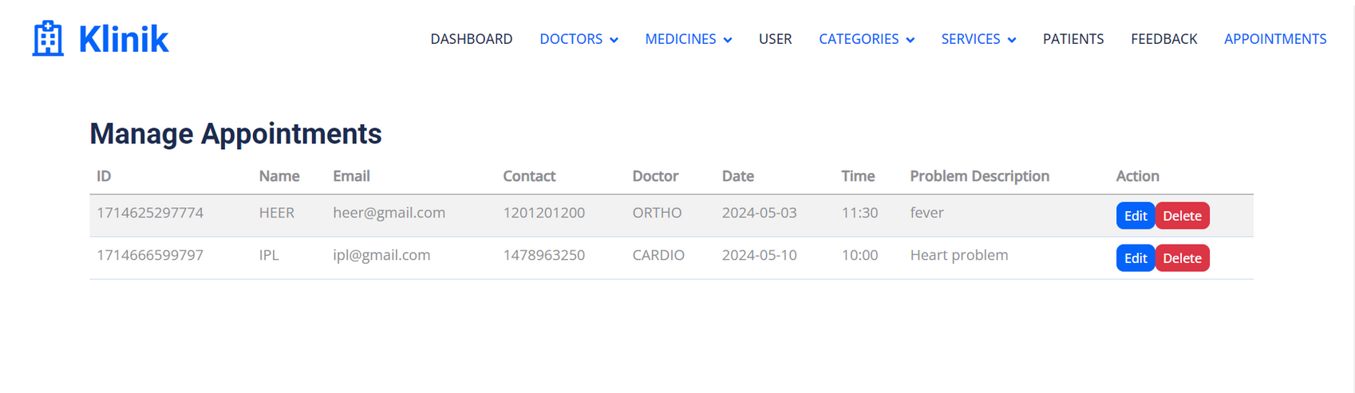
PROJECT
Aaron Loeb
Add Services
Manage Appointment
Olivia Wilson

Slide 11





THANK YOU!
Tushar Makavana
Front-end Developer
9737675658
53, Surbhi Society , New Naroda , Ahmedabad

